Slide 1

How to terraform
Anton Hryshchanka, L4, Software Engineer
.NET C# Backend/Full-stack
Stop clicking your mouse
Let's terraform something

Slide 2
Infrastructure as a Code
Infrastructure as Code (IaC) is the managing and provisioning of infrastructure through code instead of through manual processes
Pros:
I can store/extend/update infrastructure in several lines of code because they are files in the repository
I can share my infrastructure with other teams or people, review and track all changes in one place
???
Cons:
???

Slide 3
Terraform by HashiCorp
Terraform is a tool for building, changing, and versioning infrastructure safely and efficiently. Terraform can manage existing and popular service providers as well as custom in-house solutions
website: https://www.terraform.io/
sources: https://github.com/hashicorp/terraform
forum: https://discuss.hashicorp.com/c/terraform-core/27
tool: Terraform CLI
Key features:
Infrastructure as Code
Execution Plans
Resource Graph
Change Automation
How to install:
download from https://www.terraform.io/downloads.html / unpack / add to PATH
compile binary from https://github.com/hashicorp/terraform.git / add to PATH
> brew install terraform

Slide 4
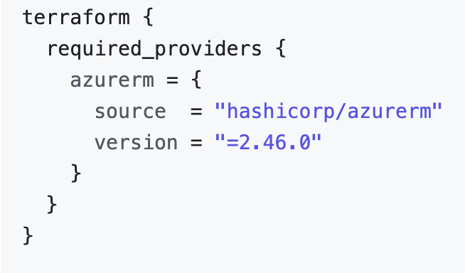
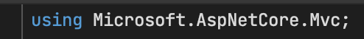
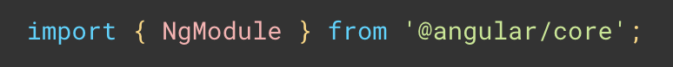
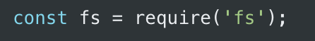


Slide 5
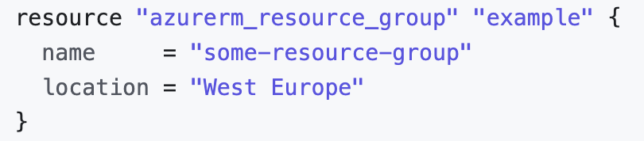
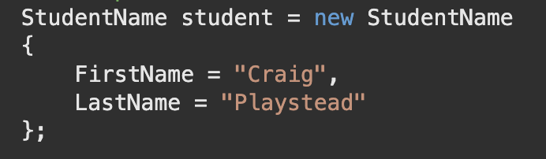
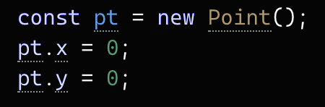
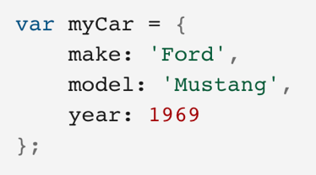
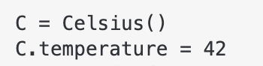

Slide 6
DEMO #0
HCL syntax and minimal example

Slide 7
DEMO #1
iterative approach

Slide 8
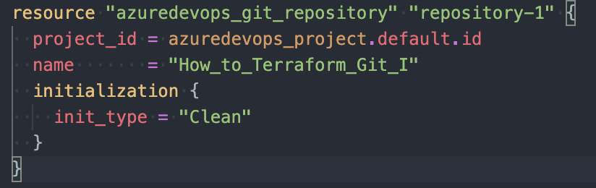
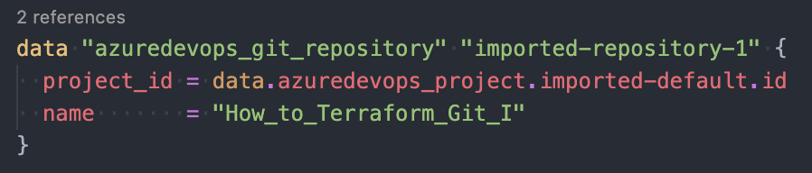

Slide 9
DEMO #2
extend existing resources

Slide 10
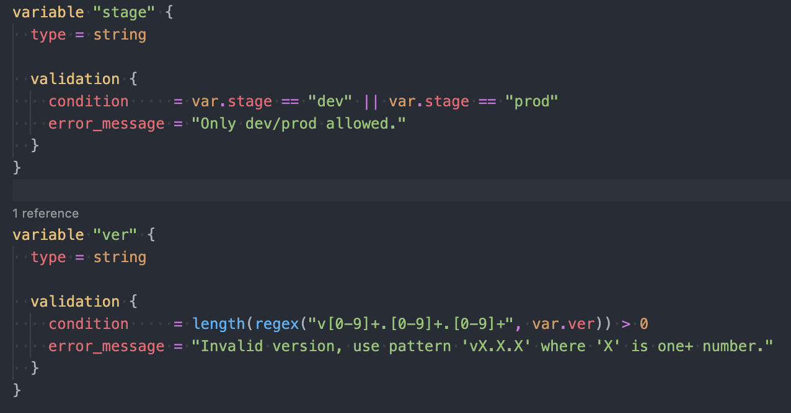

Slide 11
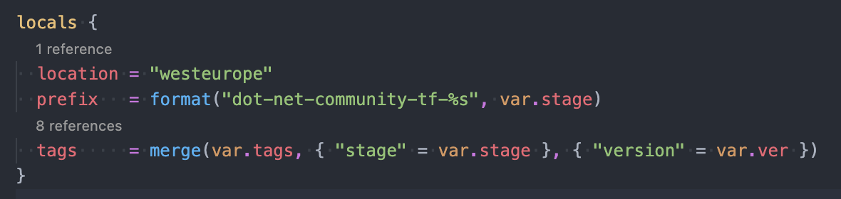

Slide 12
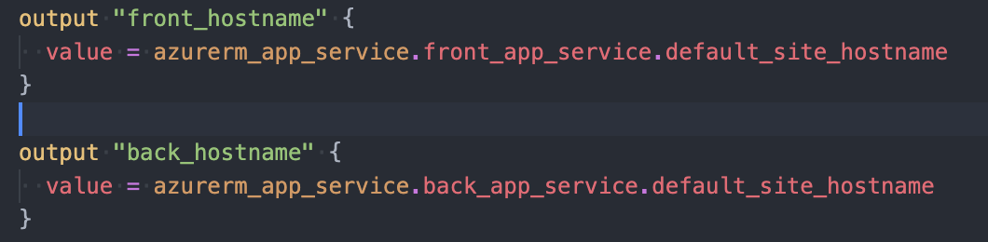

Slide 13
DEMO #3
real world example

Slide 14
Infrastructure as a Code
Infrastructure as Code (IaC) is the managing and provisioning of infrastructure through code instead of through manual processes
Pros:
I can store/extend/update infrastructure in several lines of code because its files in the repository
I can share my infrastructure with other teams or people, review and track all changes in one place, add gates and quality/security checks
If something goes wrong, I can re-deploy my infrastructure with several clicks or terminal commands
I can use community examples
I manage different infrastructures at the same approach
My infrastructure is identical every time*
My infrastructure is configurable/scalable*
Human-friendly development language, very well-written and updated documents, easy to understand*
Cons:
Increase complexity
Dependencies to versions
The changes must be codded, tested, reviewed, and only after that applied
Fails, errors, long run, issues with driver*
Sometimes it's hard to maintain code
New lines in CV : + new language, + new approach, + new process, + new mechanism of use, + new responsibility, support*

Slide 15
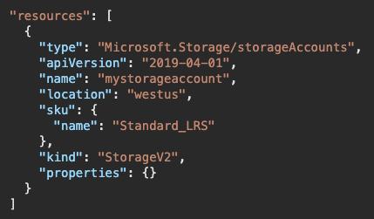
Alternatives and similar tools
Google know about:
Azure ARM templates link
Azure CLI link
Bicep by Microsoft link
Ansible link, link
Packer by HashiCorp link
Pulumi link
SaltStack link
Azure Automation link
Chef link
vRealize Automation link
Google Cloud Deployment Manager link
AWS Service Catalog link / AWS Cloud​Formation link
Puppet link
Vagrant by HashiCorp link
Cisco Intersight link
…

Slide 16
Why Terraform?
Opensource
Mature and Cutting Edge
Provisioning tool
Cloud agnostic syntax
State instead Master server/Agent
Large community
Declarative syntax (vs procedural)
Simple and powerful language
Immutable infrastructure
Terraform provides a flexible abstraction of resources and providers. This model allows for representing everything from physical hardware, virtual machines, and containers, to email and DNS providers. Because of this flexibility, Terraform can be used to solve many different problems. This means there are a number of existing tools that overlap with the capabilities of Terraform. We compare Terraform to a number of these tools, but it should be noted that Terraform is not mutually exclusive with other systems. It can be used to manage a single application, or the entire datacentre.

Slide 17
What next?
Remote state
Other providers
Modules
Terraform in CI/CD pipelines
null_provider
Unit Testing
Security check
Terraform Cloud
Tools
…

Slide 18
QUESTIONS

Slide 19
THE END

